Slide 1
Evaluating Home Renovation Opportunities in King County, WA
Analysis by Brian Bentson

Slide 2
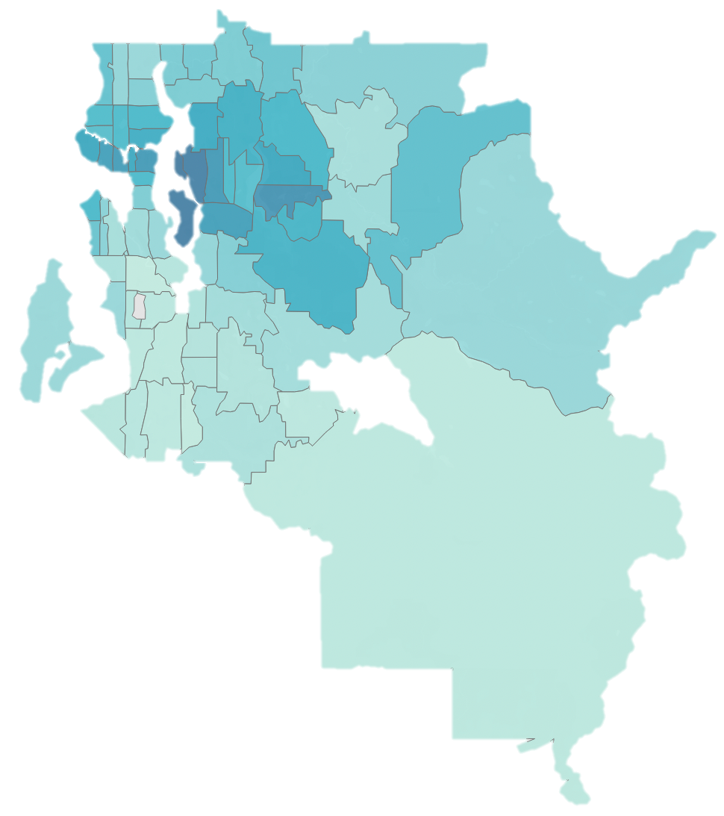
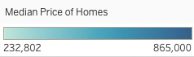
Analysis Overview
Emphasized features of a home which can be renovated that improve home value
~15,000 home sales analyzed from 2014 and 2015
Small and Midsize homes with less than 6 bedrooms
Linear Regression Modeling to understand how housing features affect price
Seattle

Slide 3
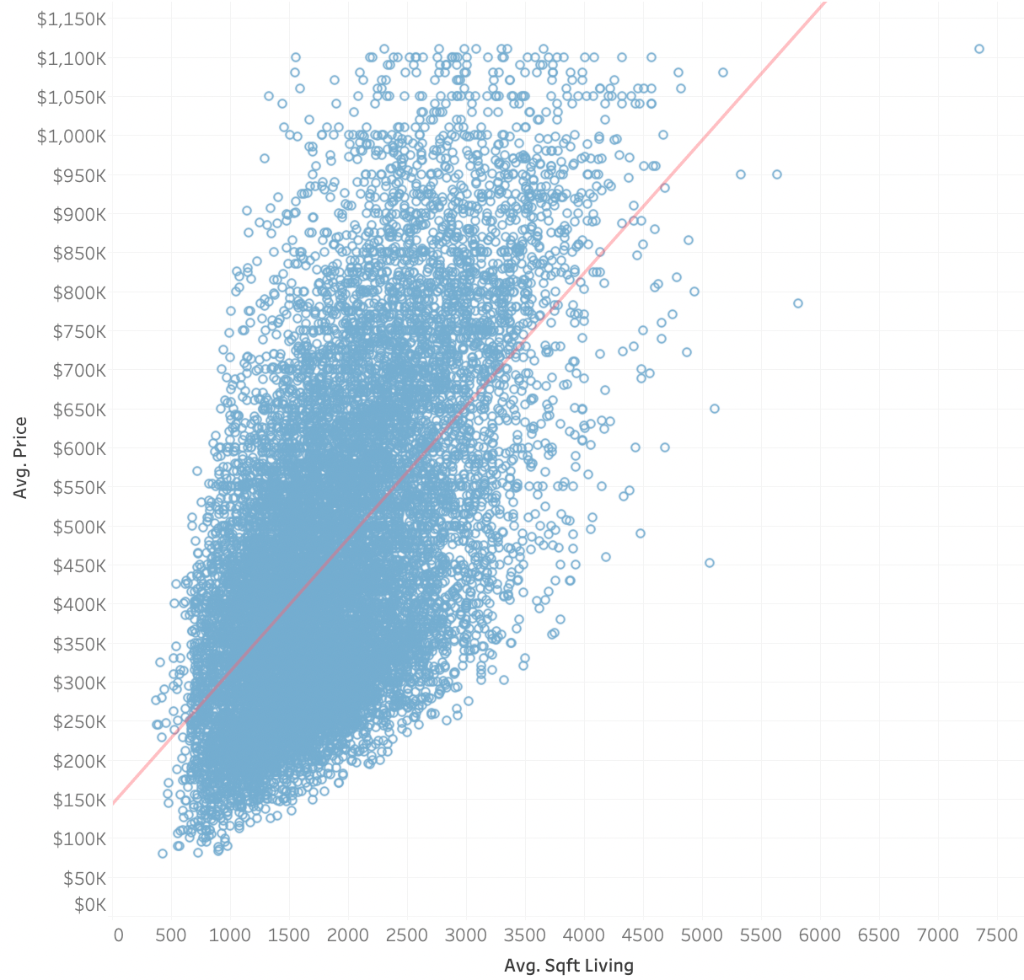
Best Fit Modeling of Home Price
Selected optimal variables that correlate with Price
Focused analysis on center of the data
Model can explain 83% of the variation in price
Mixture of controllable and uncontrollable variables

Slide 4

Biggest Drivers of Home Price
Total Square Feet dominates
Grade of construction is important
Bathrooms improve price
Basement offers a unique opportunity
Total Square Feet
Grade
View
Home Age
Condition
Bathrooms
Waterfront
Renovated
POSITIVE
Lot Square Feet
Floors
NEGATIVE
Bedrooms
Basement

Slide 5

The Grade of Construction Matters
Below Average Grades
Above Average Grades
Pay for above average construction quality and design (9-12)
Not worth it to get the absolute best grade (13)
Average construction grade is 7
POSITIVE
9
10
11
12
NEGATIVE
4
5
6
7
8
CONSTRUCTION GRADE LEVEL

Slide 6
Recommendation: Finish a Basement
with 700 sqft and High-Grade Construction
+$21,000
$81,000
Having a basement effects home price negatively by itself
Model predicts an additional $120 to the homes value for every additional square foot
Median basement size in the area is 700 sqft
+$84,000
Having a Basement
$0
Grade 9 Construction
Total Value Added
-$24,000
Adding 700 sqft

Slide 7
Recommendation: Add a Full-Size Bathroom
with 60 sqft and High-Grade Construction
+$21,000
$43,200
Having a basement effects home price negatively by itself
Adding square feet overwhelmingly offsets negative impact of basement
Median basement size in the area is 700 sqft
+$7,200
+$15,000
$0
Adding a Bathroom
Adding 60
sqft
Grade 9 Construction
Total Value Added

Slide 8
Conclusion
Finish the basement with over 350 sqft
Average basement size is 700 sqft in the area, finishing a 700 sqft basement yields $81,000
Add a full bathroom (~60 sqft)
$43,200 to the value of a home
Use high grade construction materials
Use a grade between 9-12 (above average of 7)
DO’s
DON’Ts
Item | Potential Value
Add a Bathroom | $15,000/bathroom
Add Square Feet | $120/sqft
Finish a Basement with > 350 sqft | $35,380/level
Use High Grade Construction | $21,000 for level 9
Item | Potential Value
Add a Bedroom | -$45,000
Add a Floor | -$8000
Finish a Basement with < 350 sqft | -$24,000
Notes:
The estimates for full bathroom square feet from an online search for ”average full bathroom size”.

